Slide 1
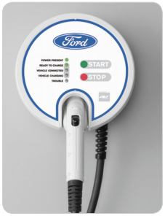

FORDCS-V1.0-Architecture Design
EDU Project
karacankos@gmail.com
https://www.linkedin.com/in/omer-karacan/
https://www.instagram.com/karacanos/

Slide 2
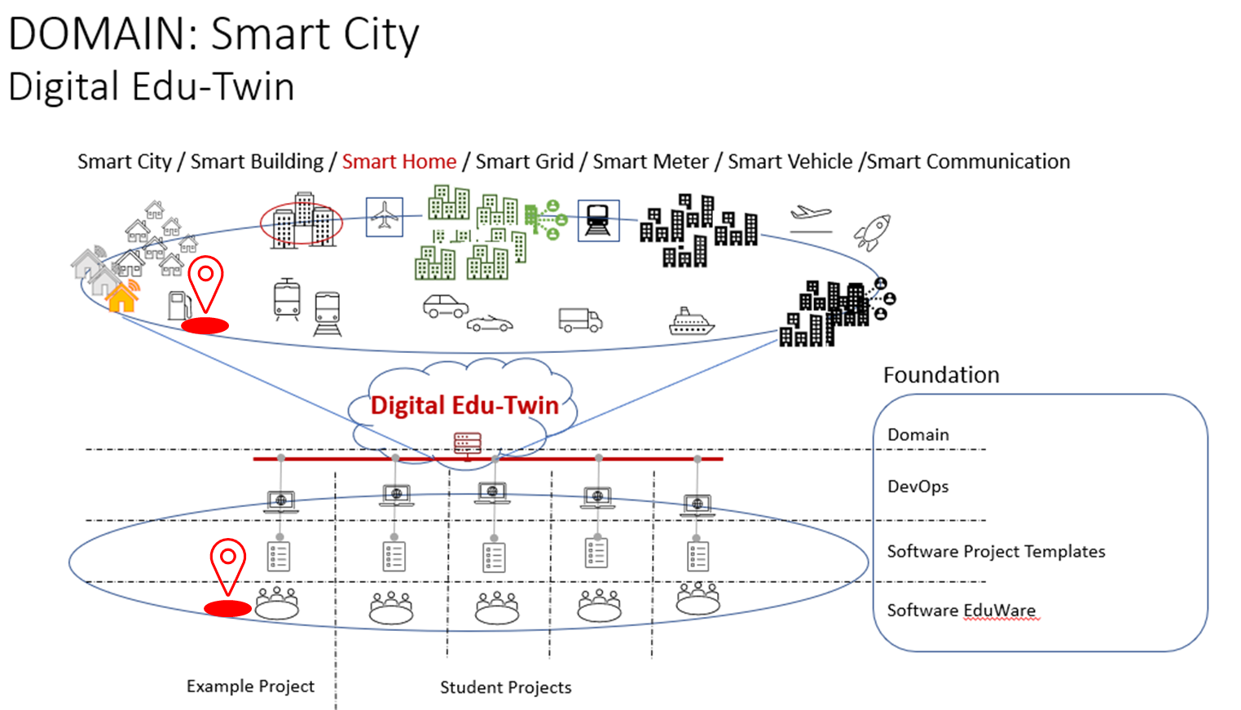

Project Context

Slide 3



FORD CHARGing Station ApplIcatIon Architecture Pattern
<SpringBootApplication,
charging-station-application>
fordcs
<Repository>
fordcsRepository
<Service>
fordcsService
<Controller>
fordcsController
Tester
Java Persistence (JAP) API
<embedded-db>
Hibernate
Developer
<persistency>
data storage
<algorithm>
business logic
<endpoints>
fordcs APIs

Slide 4
SYSTEM USE CASE Report Factory Setting V1.0
<Repository>
CsFactorySetting Repository
No persistency is needed!
<Data>
FordCSSettingDataX
SYSTEM USE CASE Report Factory Setting V1.0 satisfies the CUSTOMER USE CASE Report Factory Setting V1.0
Controller/Service/Repository component design
Service Endpoint
System Test tools
<Service>
CsFactorySetting Service
<StateMachine> FordCsFSM
https://api.example.com/api/v1/reportCsFactorySetting
GET
Returns FordCSSettingDataX
<Controller>
CsFactorySetting Controller
curl
Source: https://app.swaggerhub.com/apis/karacankos/fordcs/1.0-oas3

Slide 5
Describe the data structure
Describe the System Use Case at the system interface (webservice)

Slide 6
SYSTEM USE CASE Run-time Status Report V1.0
<Repository>
CsRuntimeStatusReport Repository
No persistency is needed!
SYSTEM USE CASE Run-time Status Report V1.0 satisfies the CUSTOMER USE CASE Run-time Status Report V1.0
Controller/Service/Repository component design
Service Endpoint
System Test tools
<Service>
CsRuntimeStatusReport Service
https://api.example.com/api/v1/runtimeStatusReport/{user}
GET
Returns <string>Status
<Controller>
CsRuntimeStatusReport Controller
curl
Source: https://app.swaggerhub.com/apis/karacankos/fordcs/1.0-oas3

Slide 7
Describe the Status and authorization rules!

Slide 8
Charging Monitor Interface V1.0
<Repository>
CsMonitorVehicleChargingState Repository
No persistency is needed!
Controller/Service/Repository component design
Service Endpoint
System Test tools
<Service>
CsMonitorVehicleChargingState Service
https://api.example.com/api/v1/ monitorVehicleChargingState/{user}
GET
Returns <string>Status
<Controller>
CsMonitorVehicleChargingState Controller
curl
Source: https://app.swaggerhub.com/apis/karacankos/fordcs/1.0-oas3

Slide 9
Describe the Status and authorization rules!

Slide 10
Charging Control Interface V1.0
<Repository>
CsControlVehicleChargingState Repository
No persistency is needed!
Controller/Service/Repository component design
Service Endpoint
System Test tools
<Service>
CsControlVehicleChargingState Service
https://api.example.com/api/v1/ controlVehicleChargingState/{user}/{event}
GET
Returns <string>New_Status
<Controller>
CsControlVehicleChargingState Controller
curl
Source: https://app.swaggerhub.com/apis/karacankos/fordcs/1.0-oas3

Slide 11
Describe the Status and authorization rules!

Slide 12
Design the System through Use Cases Analysis
System Use Case
Launch the CS V1.0
System Use Case
Charge the Car [REF_SHC] V1.0
<Controller>
CsControlVehicleChargingState Controller
<state>
t.b.c.
These System Use Cases utilize the Charging Control Interfaces!
Controllers receive the Use Case trigger requests!
Analyze Use Case Scenarios described with Activities!
Perform Controller and Service Design via Modelling the Use Case trigger request in Sequence Diagrams!

Slide 13
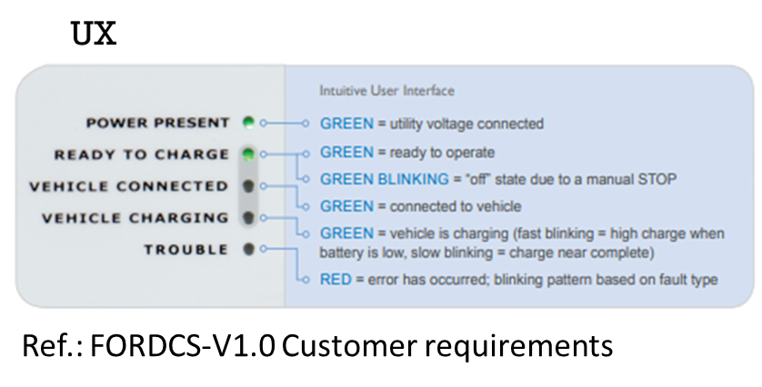
Charging statis status panel (UX panel)
UX dashboard (panel) interface
UX service and GUI design!
Interface – webservice (subscriber?)
Data reception (regularly)
GUI design (prototypish)

Slide 14
BACKYARD
Wichtige Informationen

Slide 15



FORD CHARGing FUTURE Front ends and external DB
<SpringBootApplication,
charging-station-application>
fordcs
<external-db>
UX/UI
<Repository>
fordcsRepository
<Service>
fordcsService
<Controller>
fordcsController
Java Persistence (JAP) API
<embedded-db>
Hibernate
<persistency>
data storage
<algorithm>
business logic
<endpoints>
fordcs APIs

Slide 16
Readings
CHECK: https://objectbox.io/how-ev-charging-benefits-from-edge-computing/

